Slide 1
Patient Opinion in Ireland
Tim.hunt@patientopinion.org.uk

Slide 2
Patient Opinion is
Independent
Not for profit
Social Enterprise
Integrated Across Health and Social Care
Carefully moderated
International-(Scotland, Ireland, Australia, England)

Slide 3
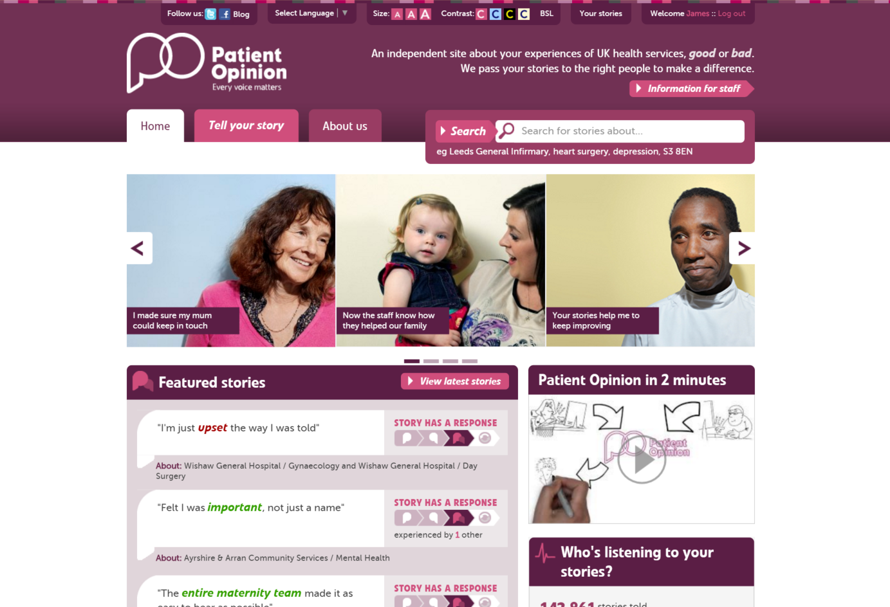

Slide 4
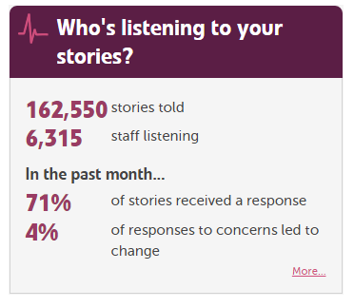

Slide 5
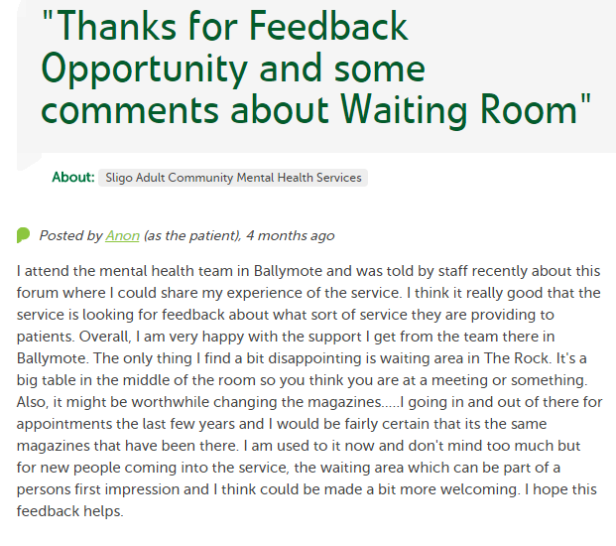

Slide 6
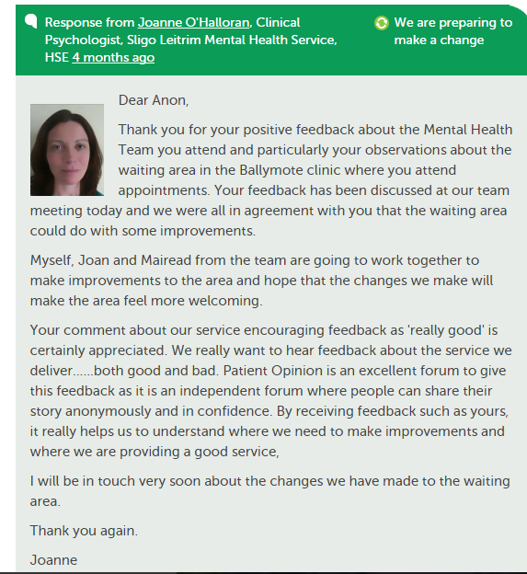

Slide 7
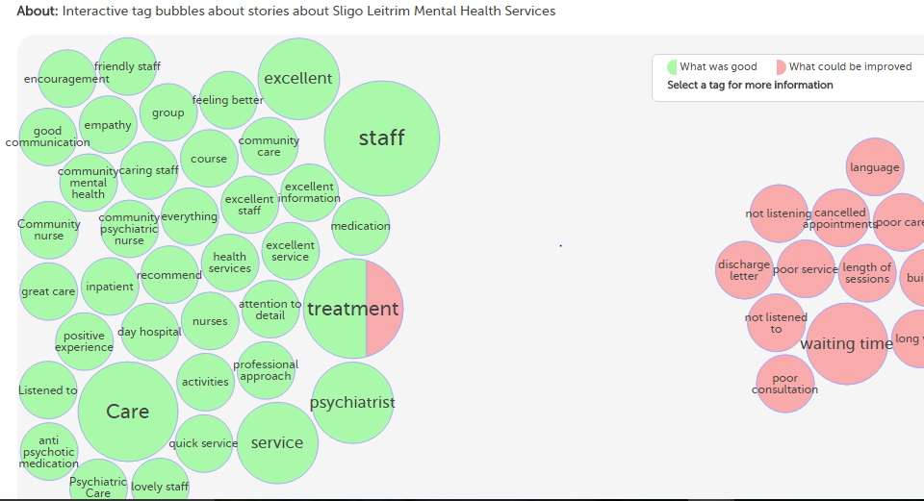
Visualisation Overview

Slide 8
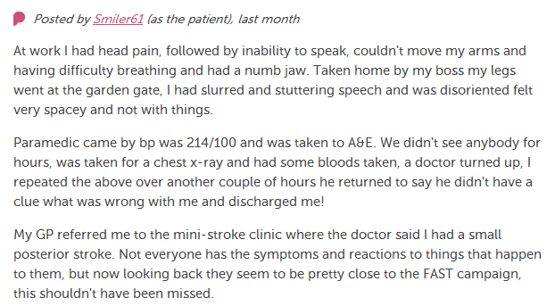
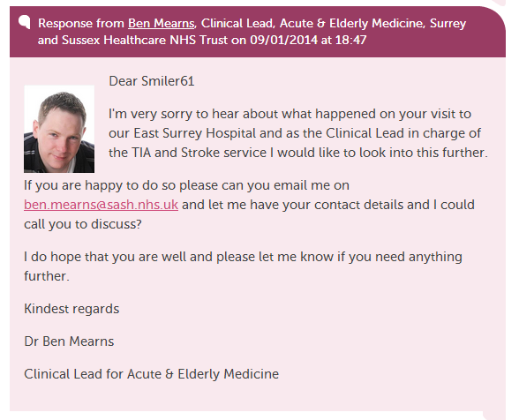
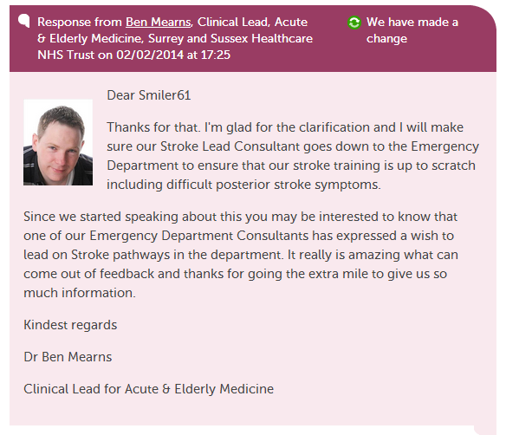
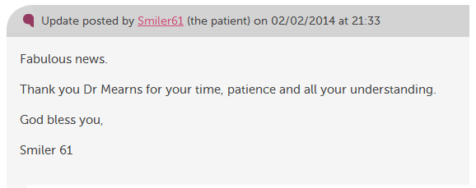


Slide 9
Patient Opinion-Our Mission
We care about giving people a voice (not a survey), and ensuring their voice is heard (not measured).
We start with the story authors want to tell, but ensure that its valuable to services.
We think we can help change care by connecting people, more than by collecting data.
And we do all of this, as far as possible, in public so that everyone can benefit.

Slide 10
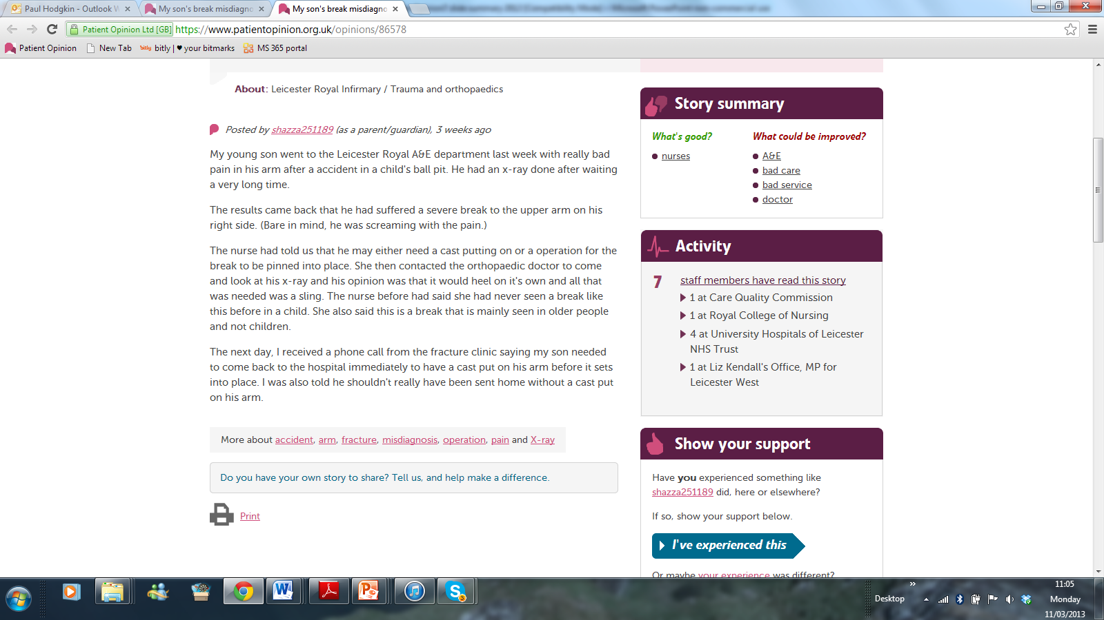
Patient Organisations
CQC and Monitor
GP Consortia
Automatic notification
Story
Relevant staff
Response
Comment 1
Comment 2
Patient
Service improvement
Comment from patient
HealthWatch, H&W Boards
National government, and MPs
What happens to your story

Slide 11
Patient Opinion in Ireland
Postings from across Ireland-Providers alerted with positive reactions
Sligo subscription in place
HSE agreed to widget on the site
Increased activity on social media-Facebook and Twitter

Slide 12
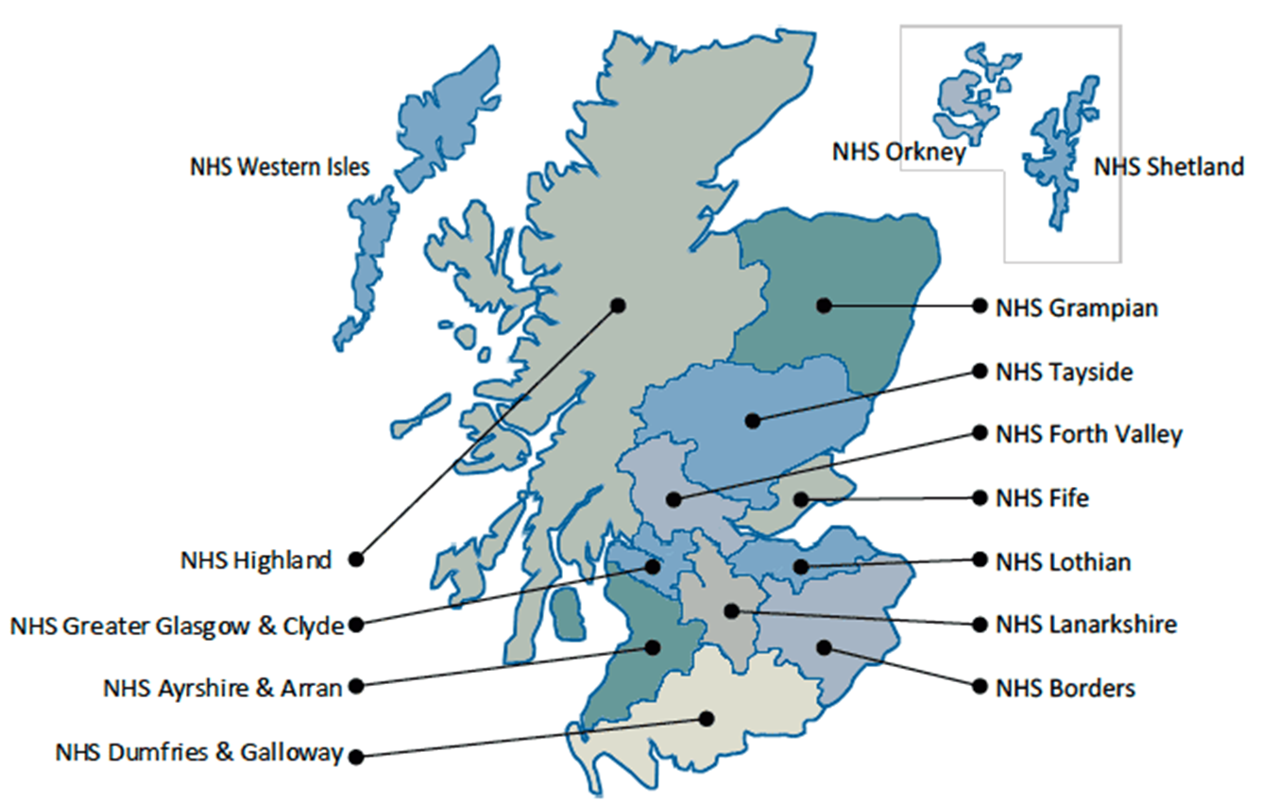
Patient Opinion in Scotland
All territorial health board
Scotland wide services
Scottish Ambulance Service
NHS 24
Golden Jubilee National Hospital
National Services
Healthcare Improvement Scotland
NHS Education for Scotland
NHS National Services Scotland
The State Hospital

Slide 13
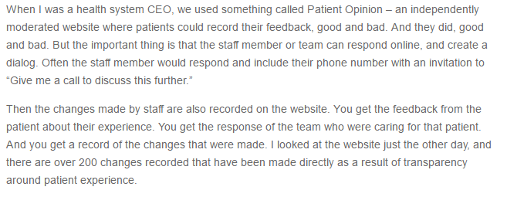
Facing the Fear of Transparency October 2016
Derek Feeley
President/CEO, IHI
(formerly CE/DG of NHSScotland)

Slide 14
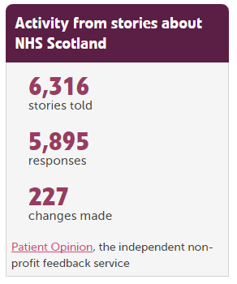
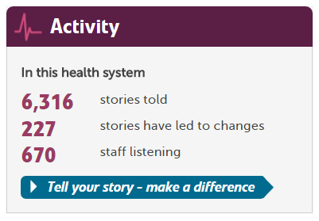

Slide 15
Berwick Report, August 2013
Recommendation 8
“All organisations should seek out the patient and carer voice as an essential asset in monitoring the safety and quality of care.”

Slide 16
HSE National Healthcare Charter
If quality and safety is to be at the heart of everything that we do, we must understand it from the perspective of patients

Slide 17
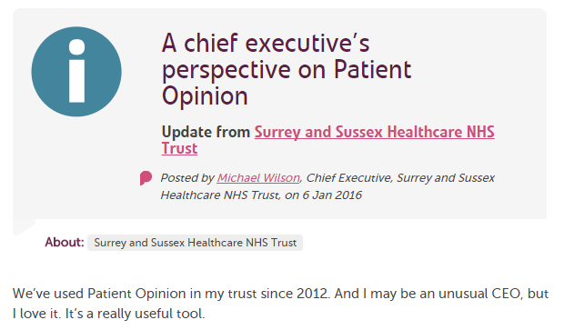
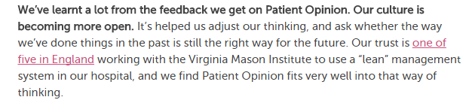

Slide 18
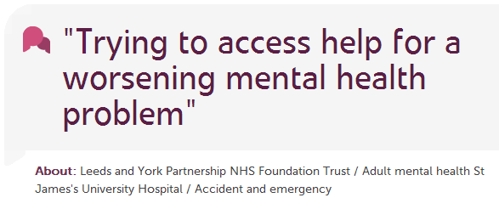
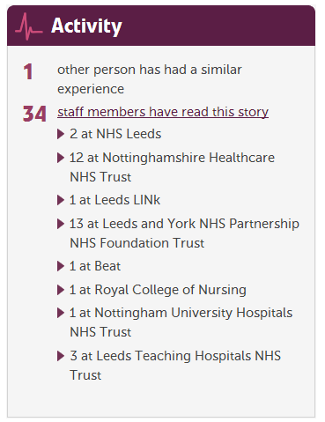
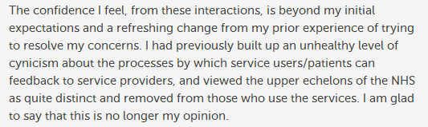

Slide 19
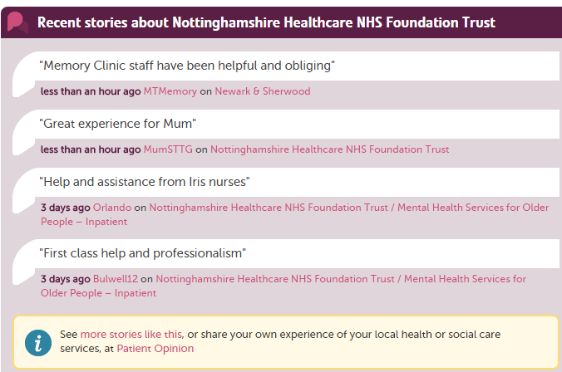
STORY WIDGETS

Slide 20
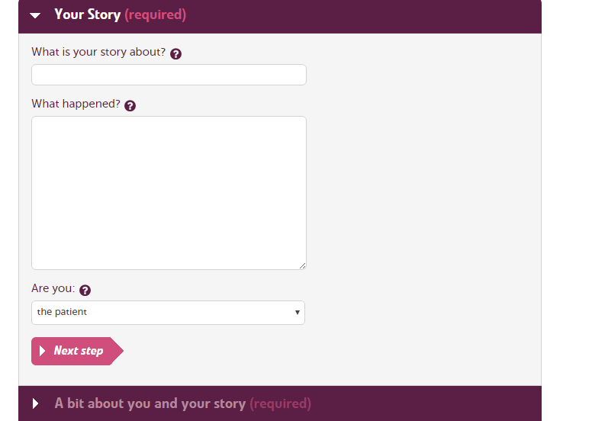

Slide 21


How stories improve integration across health and social care
Care Home
“The ambulance arrived quickly”
Daughter
Ambulance
Local NHS FT hospital
Ambulance
“We really liked the step down home
but it was awful arriving there at 22.00
after waiting all day for the hospital to
discharge her”
Daughter
Step down facility
Ambulance
Social care
Care Provider
Health services
“We used to find residents coming
back to us late at night so it was great to
see the new arrangements working”
Care home comment
Community physio

Slide 22
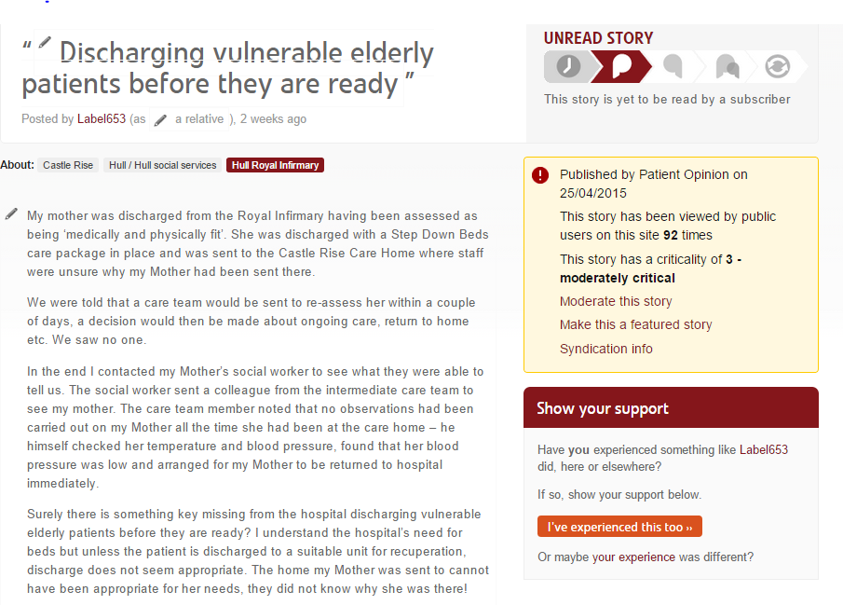

Slide 23
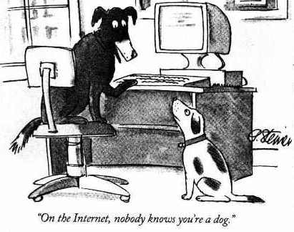

Slide 24
The world is changing – fast
Old world | New world
Hierarchy | Network
Broadcast | Conversation
Hiding | Sharing
Few | Many
Closed | Open
Passive recipients | Active participants

Slide 25
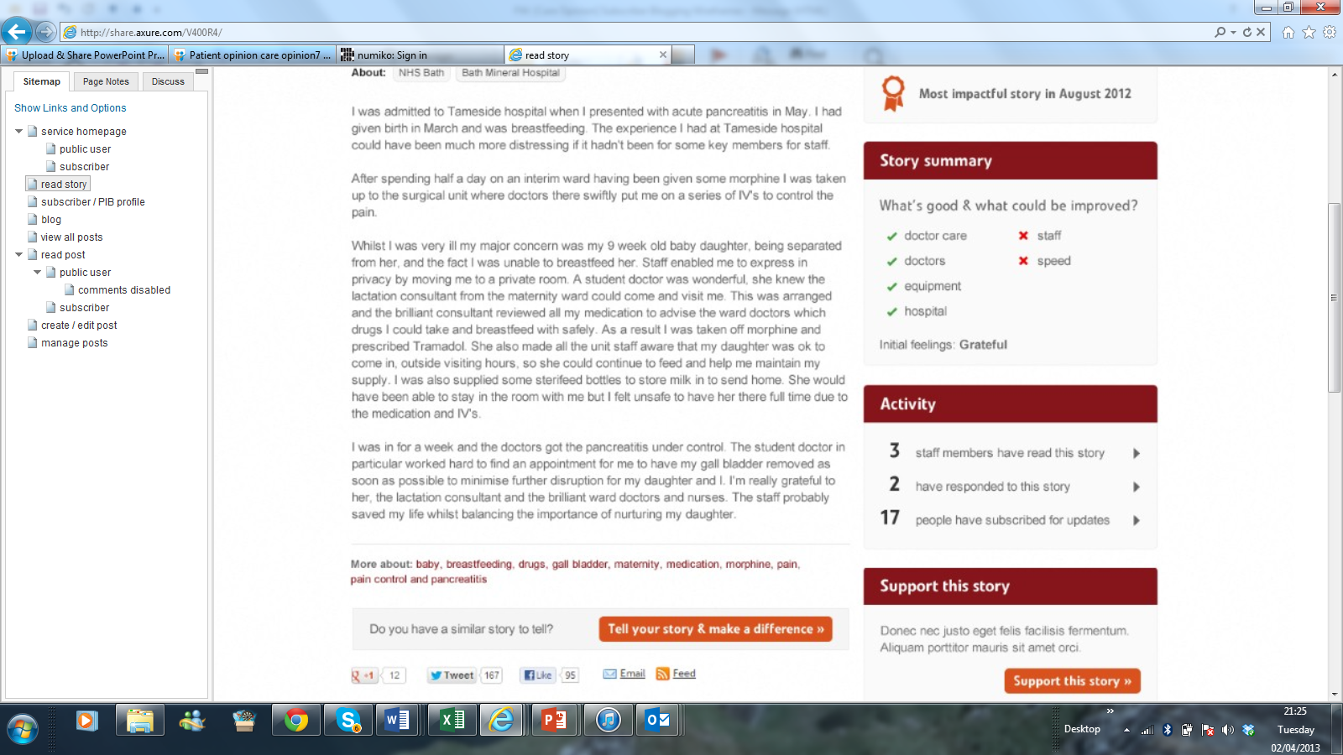
Making Communities of Practice and Communities of Solidarity visible to each other
Community of practice
Community of solidarity
staff
F&F
staff
F&F
staff
patient
staff
Conversations
F&F
staff
F&F
F&F = Friends and Family

Slide 26
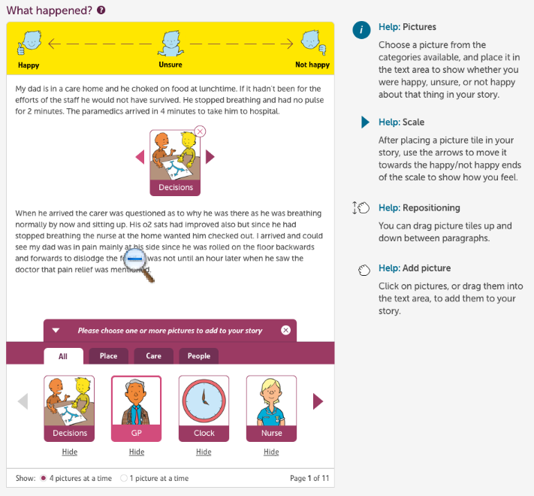

Slide 27
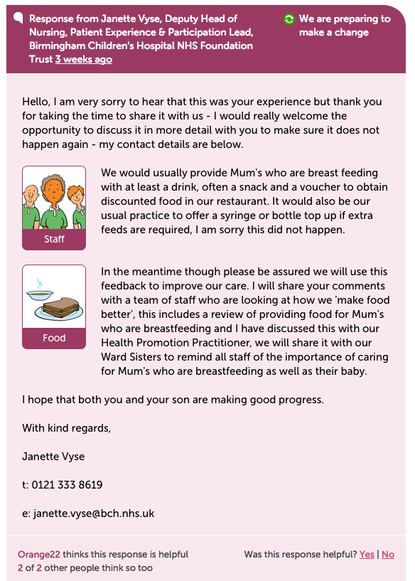

Slide 28
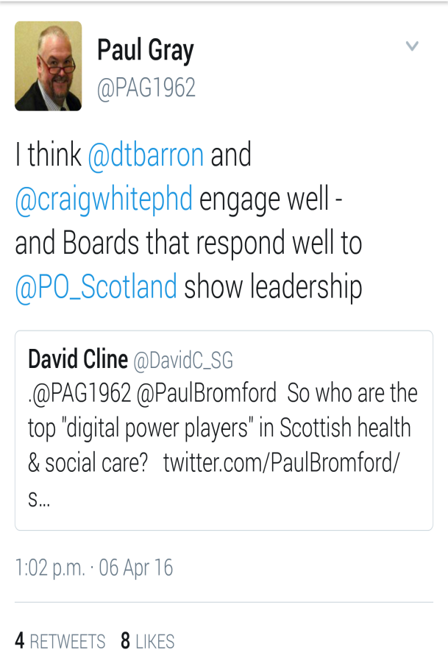

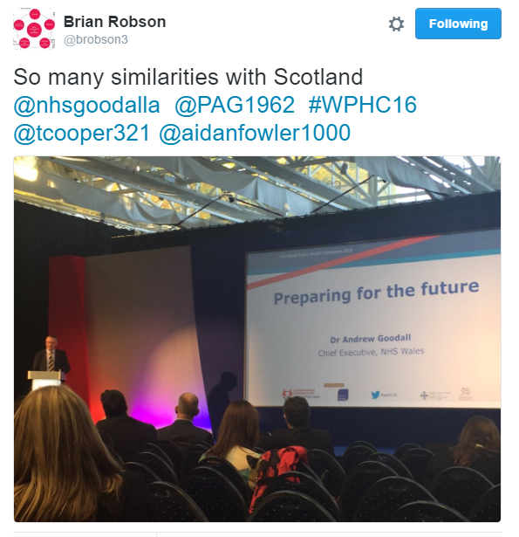

Slide 29
What Next?
Generate postings over the coming weeks
Other organisations to discuss their options
Engage with postings to link with quality and service improvements.
Follow up e mail from Patient Opinion
Explore the site

