Slide 1


Introduction to Care Opinion – The Basics

Slide 2
Aims
Generating stories on Care Opinion – Promotion within services
Managing your log in – Updating your profile & finding your service
Responding to a story on Care Opinion
Q&A

Slide 3

4 ways of sharing a story
Online careopinion.ie
Freepost leaflets
Via a Kiosk link/Invitation Links
With support from Volunteers
All stories are subject to moderation and are uploaded to the website
Care Opinion is a social enterprise and independent from the HSE. We want people to be able to share their experiences of health & care in ways that are safe & simple and lead to learning & change.

Slide 4
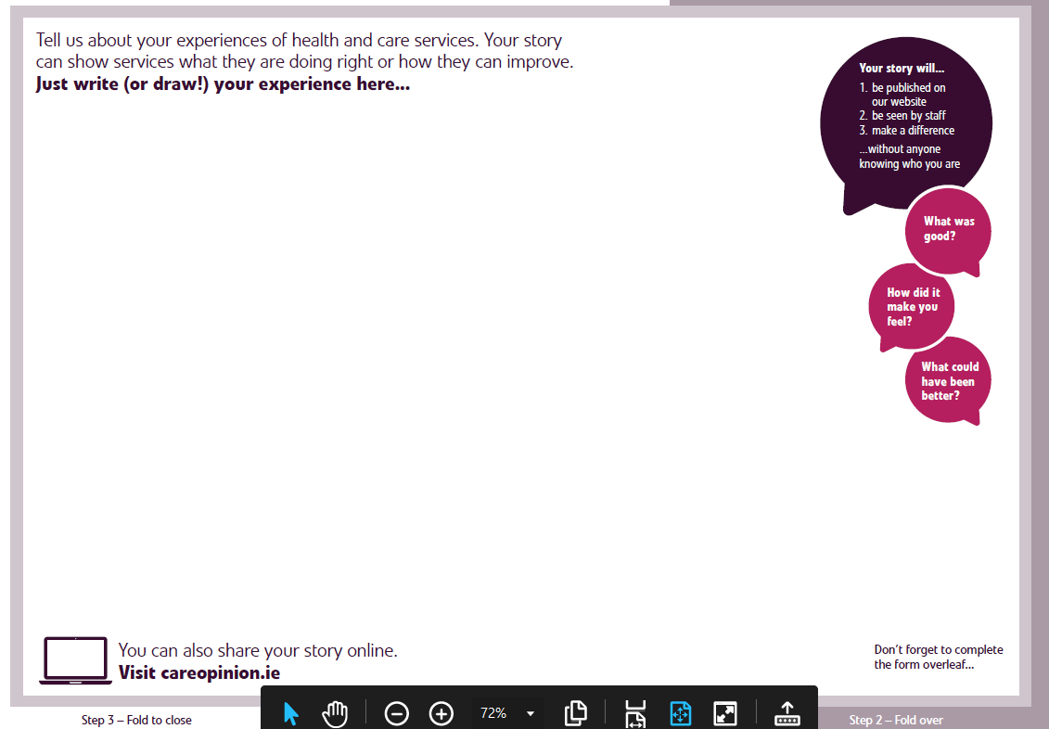

Notes:
FB

Slide 5

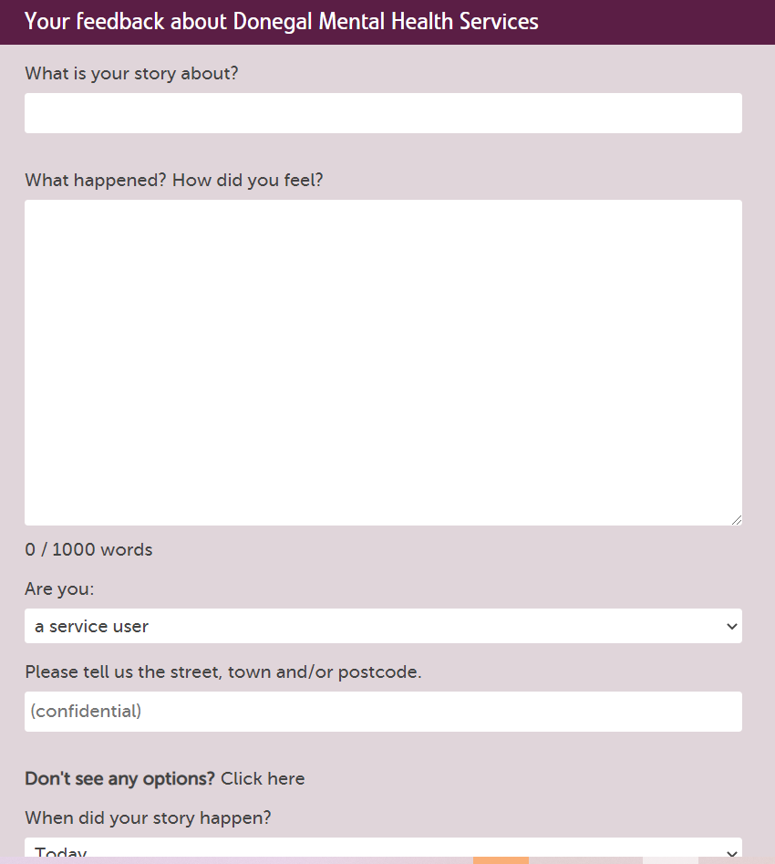
Kiosk mode (Feedback link)

Slide 6

Other use for Kiosk Mode/Invitation Links
Text or email the kiosk mode Invitation link out to ask for feedback:
“We’d love to hear your story of using our service, Tell us
what was good or what could be improved at Care Opinion using the link below: https://www.careopinion.ie/kiosk/donegal-mental-health”
”
How to use Kiosk mode after a remote consultation

Slide 7

Staff & Volunteer resources on the Care Opinion site:
Click this link

Slide 8
Volunteers can:
Let people know about Care Opinion as a way to give feedback
Show people the website and how it works
Let people see stories already shared about the service
Explain why the service would like to hear feedback and what they will do with it
Help people to login & support people to share their story on the website
Help people to write their story and put this on the website
Make sure responses get back to people who don’t have internet access.

Slide 9


Slide 10


Slide 11
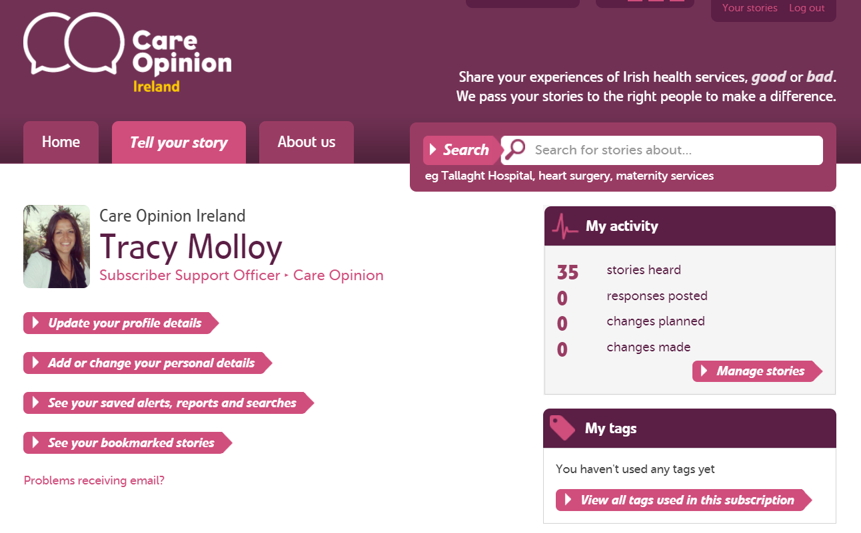
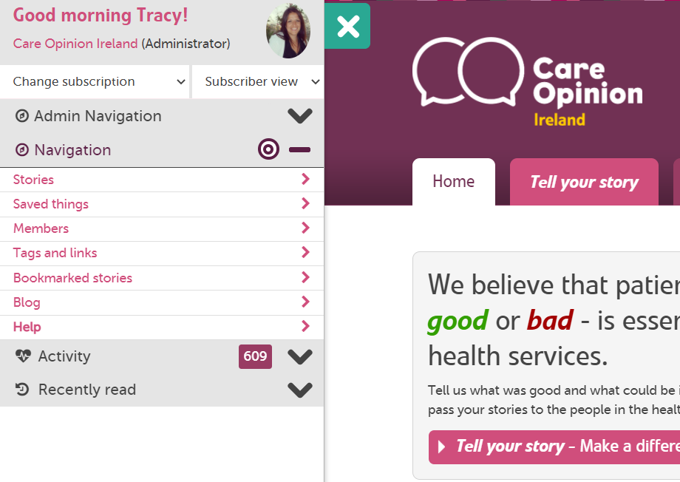

Slide 12
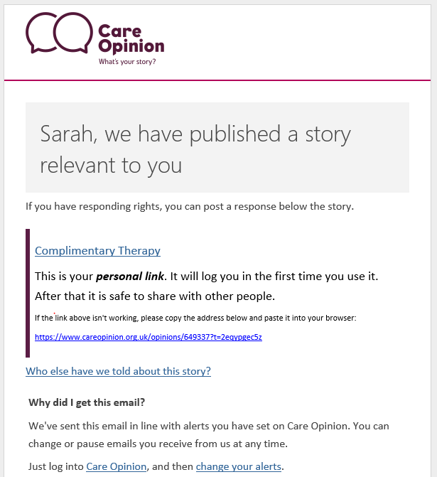


When a story that is relevant to you is published, Care Opinion sends you an email alert
The link only log’s you into the site the 1st time

Slide 13
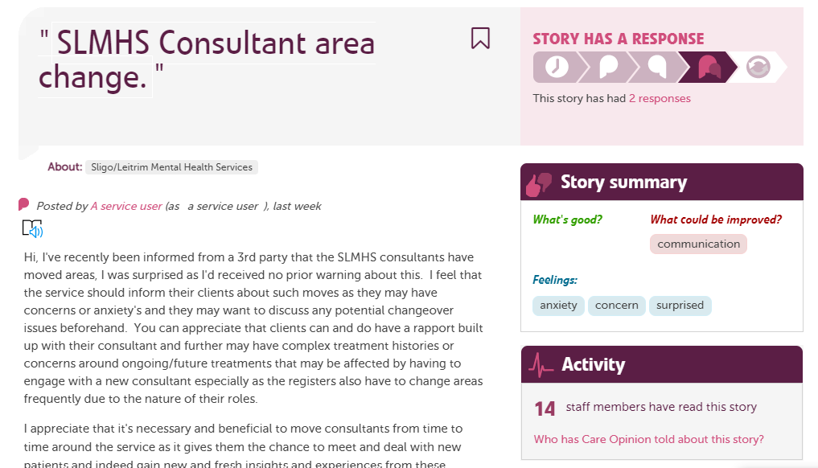

Slide 14
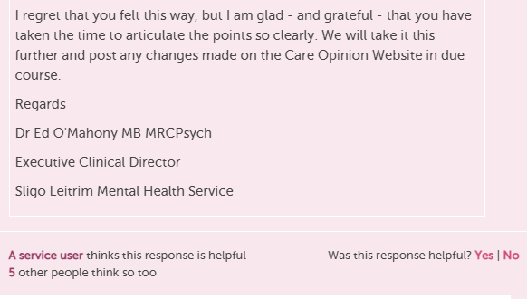
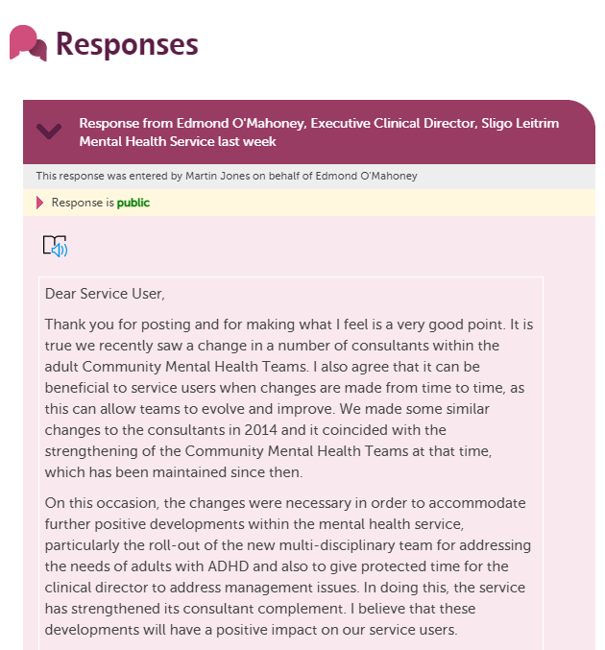
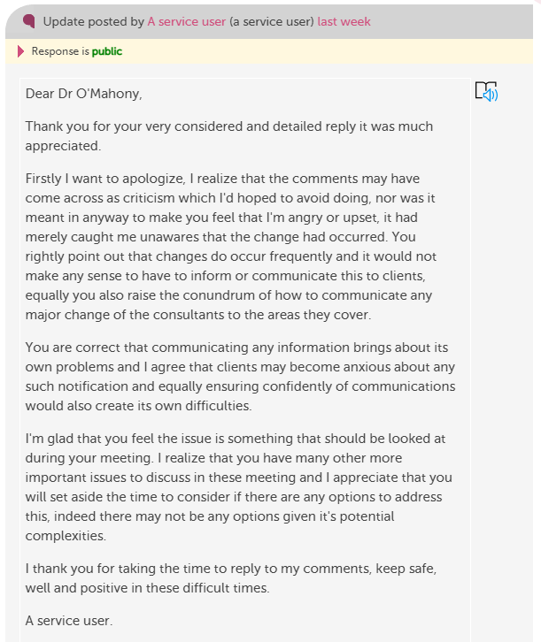

Slide 15
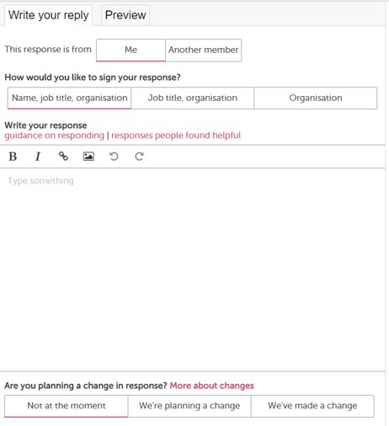
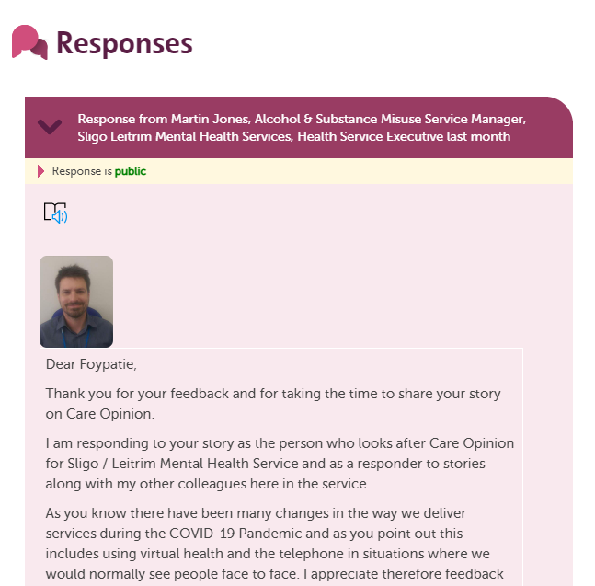
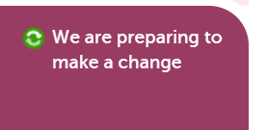

Use the preview button to see what your reply will look like

Slide 16
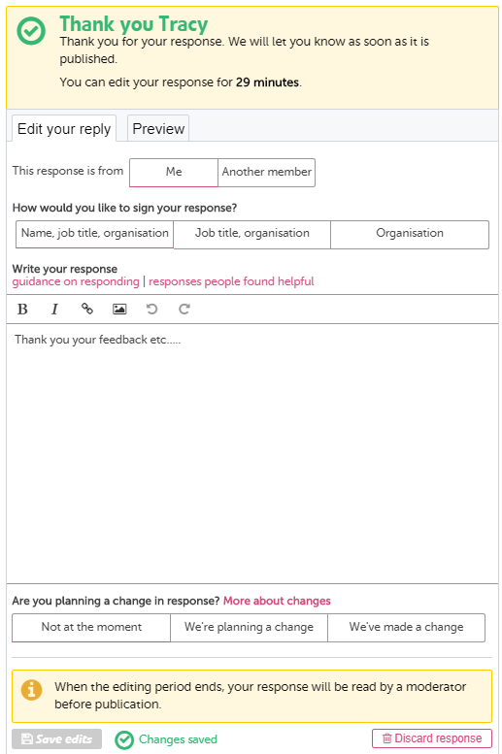
Check you get this green tick after submitting your reply. This means we have received it
You have 30mins to edit before it is sent to our moderators. Update the text and press “save edits”

Slide 17
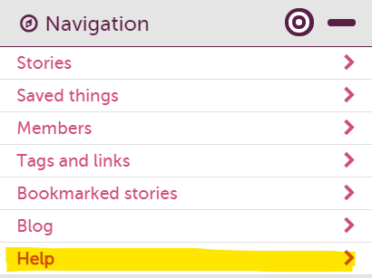

How do I access support around Care Opinion?
Contact your CO lead within your service
Use the ‘Help’ in your navigation drawer
Use the support pages – in the website footer
Register for a ‘How to…’ webinar
Contact the support team at Care Opinion
email info@careopinion.org.uk

Slide 18
Any questions?
Blog post: Launch of Care Opinion in Ireland

Slide 19
Thank
you

