Slide 1

A Start Up Guide
Notes:
This is a short guide to Care Opinion which is a not for profit social enterprise founded 12 years ago. CO is the leading independent feedback platform committed to giving the public a voice and providers the opportunity to respond.

Slide 2
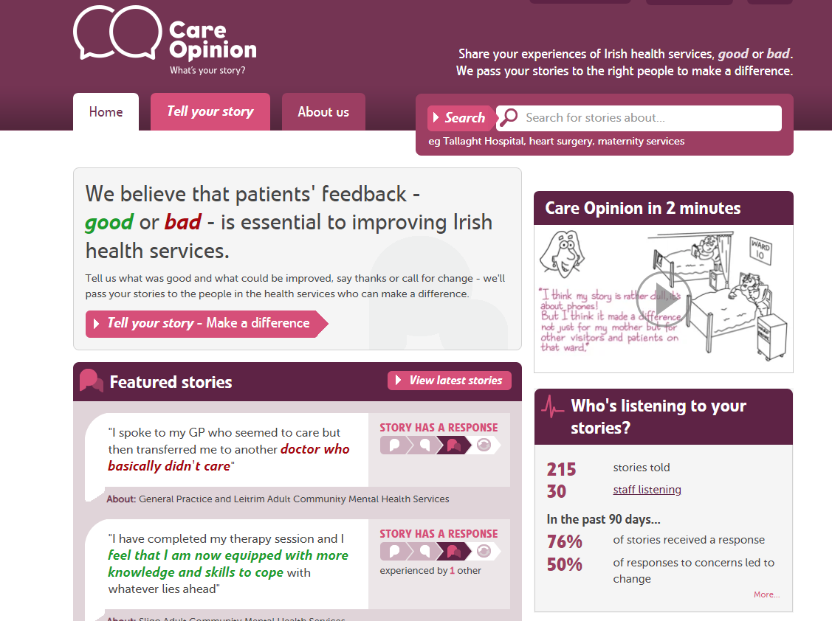

Slide 3
The Care Opinion Mission
To provide an online platform so that:
people can share honest feedback easily and without fear
stories are directed to wherever they can help make a difference, and
everyone can see how and where services are listening and changing in response

Slide 4
Benefits
For patients and families
  Safe, simple, transparent feedback loop
  Issues resolved, service changes
For staff teams
  Learning, Quality Improvement, morale, culture
For the wider organisation
  Transparency, reputation, complaints
Notes:
Does not replace formal complaints but authors sometimes feedback on the site as an alternative. Postings are public and seen by a wide range of stakeholders. There is a staff resource pack to help with posting generation as well as a range of materials. Please ask the subscriber support team.

Slide 5
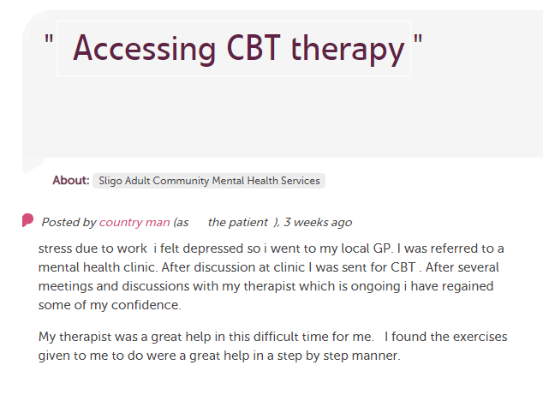








In each provider
Moderation
Clinical staff
Different Staff Teams
Customer Experience, comms, complaints…
Alerting
Nursing, AHP students
Other Stakeholders
Researchers
HSE
Notes:
Stories come in and all are moderated. Alerts can go out then to a range of stakeholders and interested parties. Stories are also tweeted out and shared on social media by CO and provider organisations.

Slide 6
Keeping Staff and Authors Safe:
All stories and responses are read by an expert team of moderators before they are made public
Staff are not named as part of any negative comments and details are removed to prevent jigsaw identification
Care Opinion have Safeguarding and Vulnerable Persons policies as part of their robust moderation policy and processes
The Care Opinion team are always available to discuss any queries with via email or phone.
info@careopinion.ie 01 254 9390
Notes:
Care Opinion has a highly evolved moderation policy that is informed by legal advice.

Slide 7
Quotes from our Care Opinion Author Survey 2017
“She really does deserve praise, and I am grateful for this site where staff can be highlighted for doing a great job”
“I wasn’t sure if I was doing “the right thing” by posting on Care Opinion, but I am so glad I did, hopefully lessons will be learned from my experience”
“I feel empowered and understood and believed and respected”
“A necessary route for voicing opinion but without making a formal complaint”

Slide 8
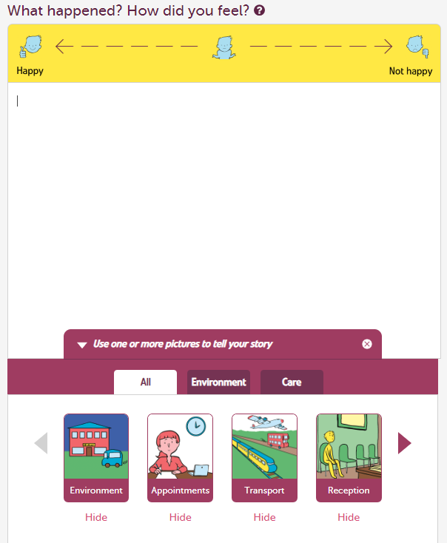
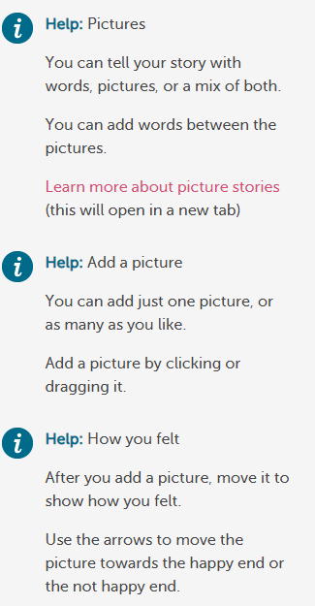
Picture Tiles Storytelling

Slide 9
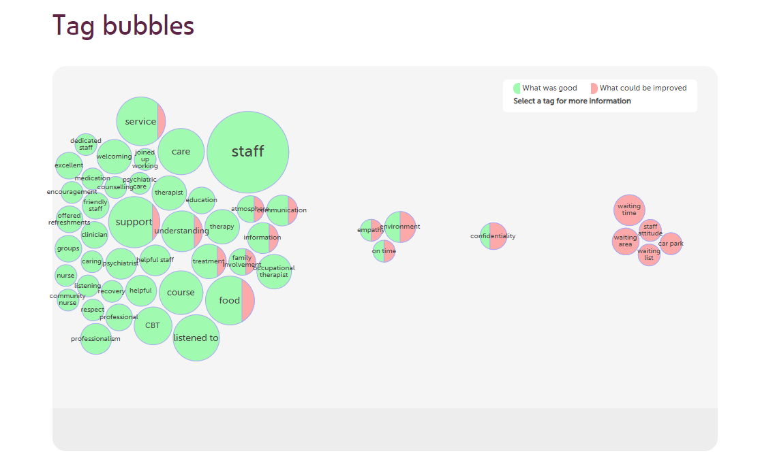
Sligo Leitrim-Feedback by Themes

