Slide 1
Care Opinion launch for Sligo, Leitrim and Donegal Mental Health Services
James Munro, CEO, Care Opinion CIC
@jamesfm55
@careopinion

Slide 2
Welcome!
2-3pm | Setting the scene Dr James Munro, CEO, Care Opinion Dr Ed O’Mahony, Executive Clinical Director, Sligo/Leitrim mental health services Dr Ann O’Brien, National University of Ireland/Galway Dr Maura Finnegan, Principal Clinical Psychologist, Donegal MH Services
3 - 3:10 | Comfort break
3:10 - 3:30 | Questions and discussion
3:30 – 3:40 | Next steps Patrick Nwaokorie, Area Lead for Mental Health Engagement, HSE Tim Hunt, Integration Development Manager, Care Opinion

Slide 3
Before we start
We will record the session
We will share the recording and the slides on our blog afterwards
We will email everyone with a link once the blog is published
Feel free to post questions and comments in the chat box

Slide 4
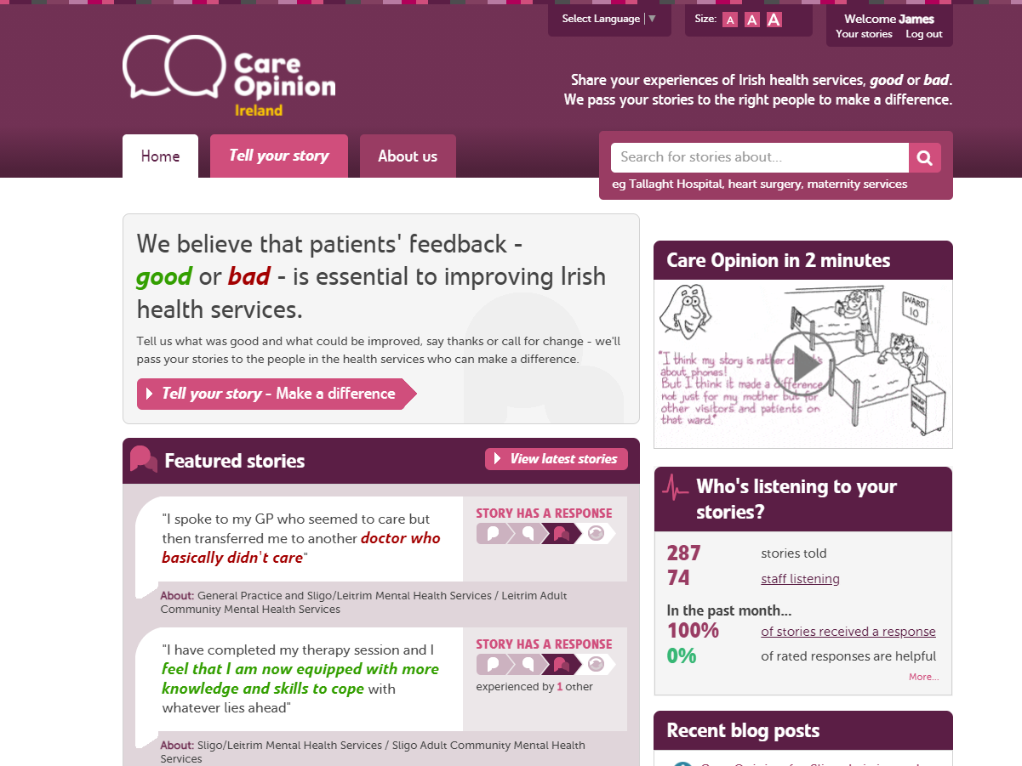

Slide 5
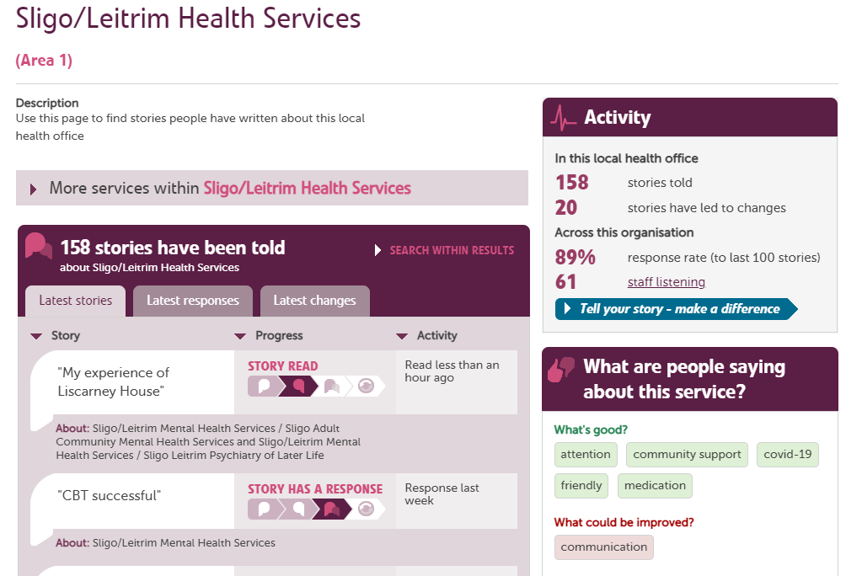

Slide 6
Vision
We want people to be able to share their experiences of health and care in ways which are safe, simple, and lead to learning and change.

Slide 7
“It was a difficult time for me to go through and Care Opinion allowed me to control the speed and words rather than be rushed through Q&As or tick box scenario where things don't quite fit.”

Slide 8
“The fact I did not have to give my name made it a lot easier to provide feedback. I find it hard to do it in person.
I would like it to make changes.”

Slide 9
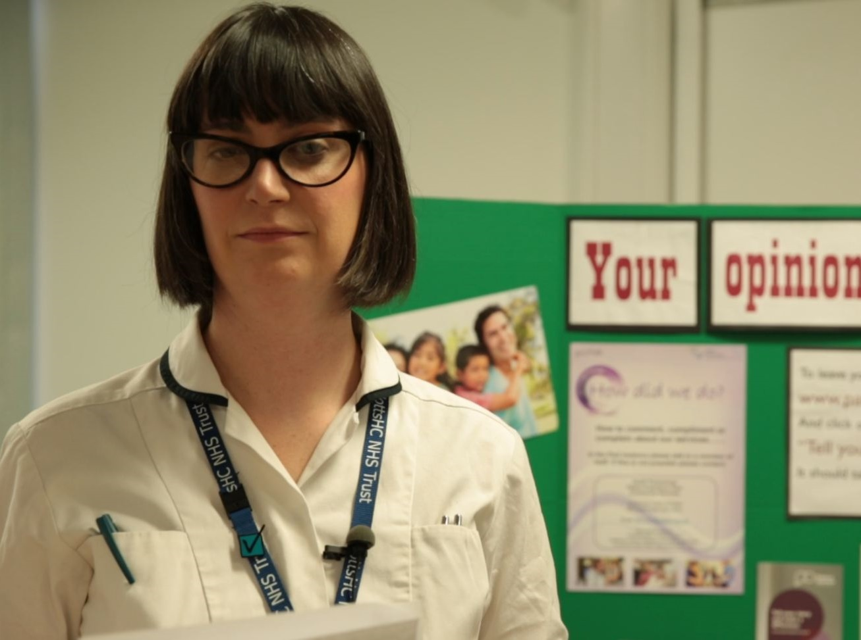
“More than just listening, it has helped us to focus on what we can change to improve our service.
We’ve learnt that Care Opinion gives patients a powerful voice, which in turn has empowered us.”
Lisa Metcalf podiatrist

Slide 10
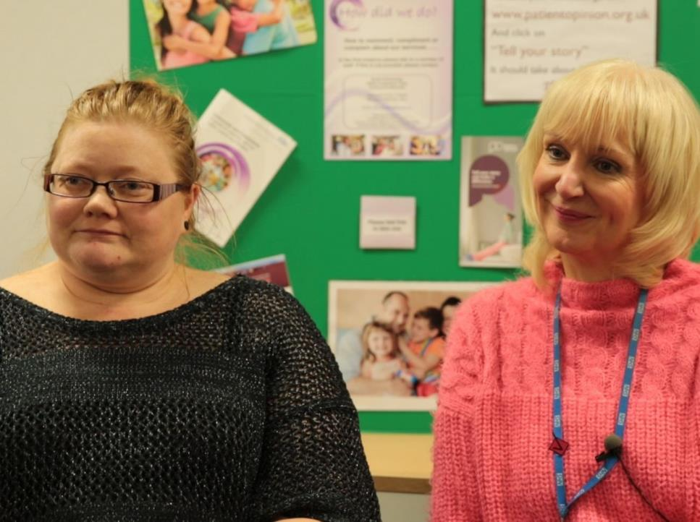
“As we’ve been on a journey, so have the users and carers been on a journey. They now have trust in us, to know that we do want to hear it, warts and all, and that we will work on what the issue is.”
Jenny Newman and Sue Dyke, public engagement

Slide 12
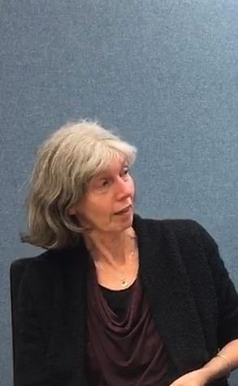
“It’s brilliant for the patients but it’s also brilliant for the staff, because they can see the feedback.
And then they want to make it better.”
Dr Deborah Colvin, general practitioner, The Lawson Practice

Slide 13
