Slide 1


Care Opinion
IRELAND

Slide 2

What will today’s session cover:
Who we are and what we do
Why we do what we do – our mission & values
How do people share their feedback?
Keeping it safe - Moderation
Benefits
Care Opinion Myths
Reports

Slide 3
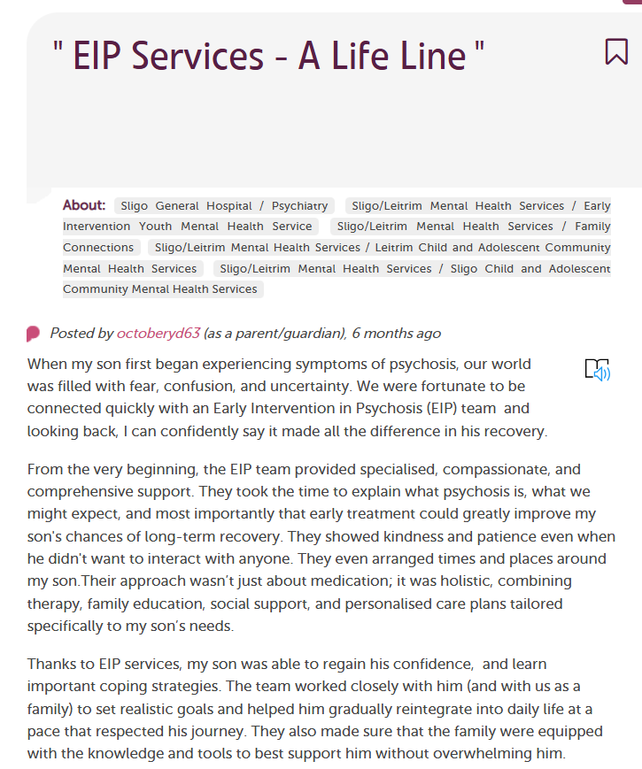
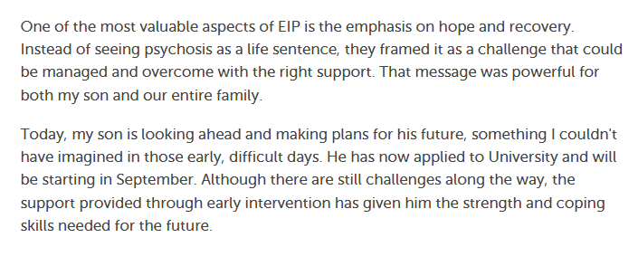
https://www.careopinion.ie/1977

Slide 4
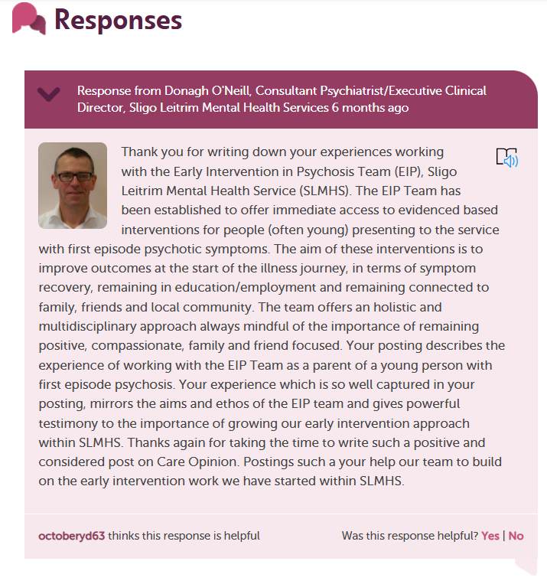

Slide 5
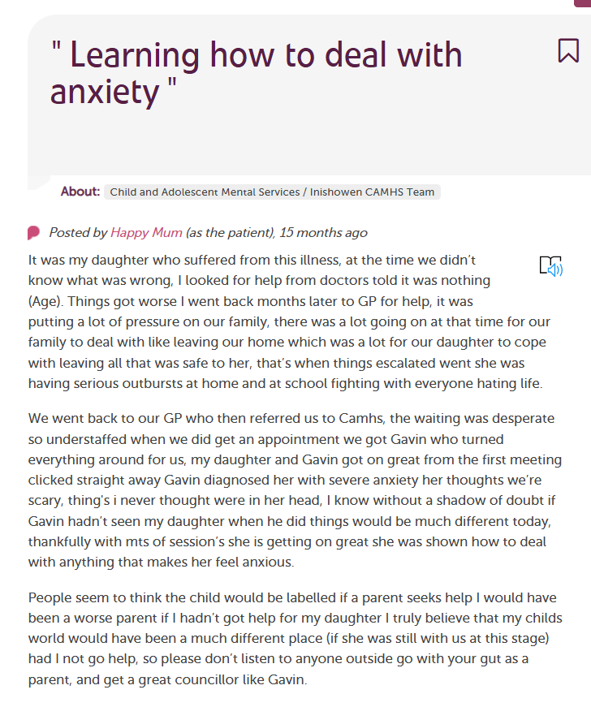
https://www.careopinion.ie/1861

Slide 6
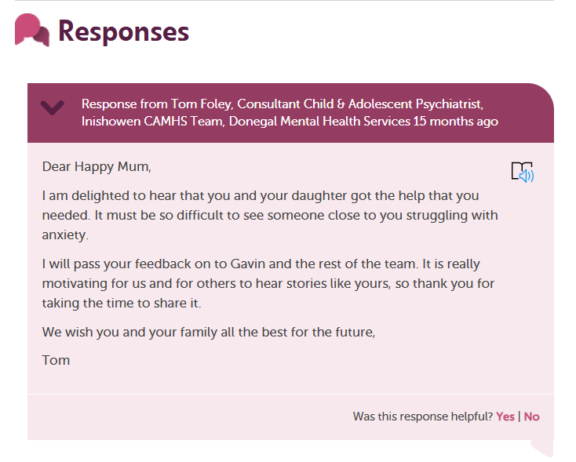

Slide 7
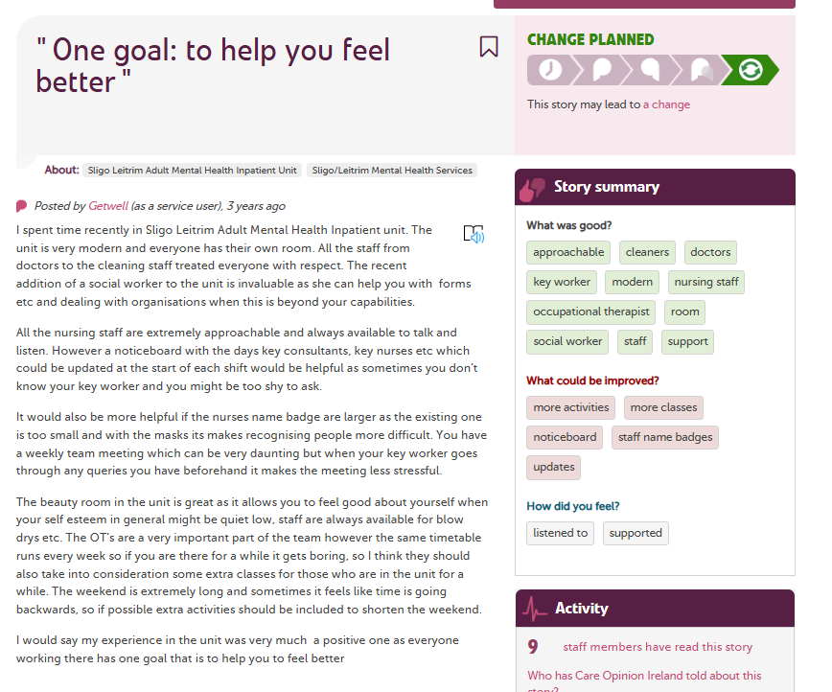
https://www.careopinion.ie/1701

Slide 8
https://www.careopinion.ie/1701

Slide 9
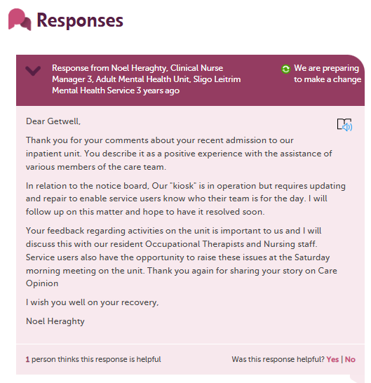
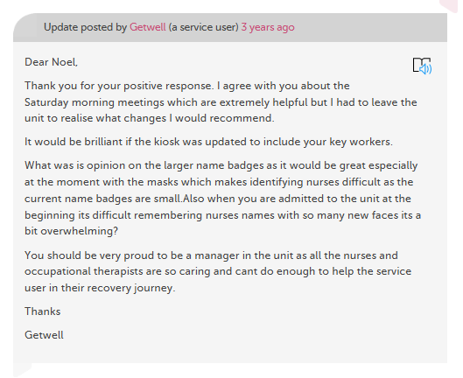
https://www.careopinion.ie/1701

Slide 10







Care Opinion is a place where people can share their experiences of health or care services
At Care Opinion we make it safe and simple to share stories of care online and for people to see other stories too. The public, services and regulators can see how stories are leading to change.
We think that by sharing honest experiences of care, we learn to see the world differently. Working together, we can all help make care better. As a social enterprise, this is very important to us.
Notes:
So what exactly do we do here at Care Opinion? We help people to share their feedback about health and care services easily and safely.

Slide 11






Ways to share your story…
We also have some printed materials and online tools to promote Care Opinion and encourage people to share their stories

Slide 12
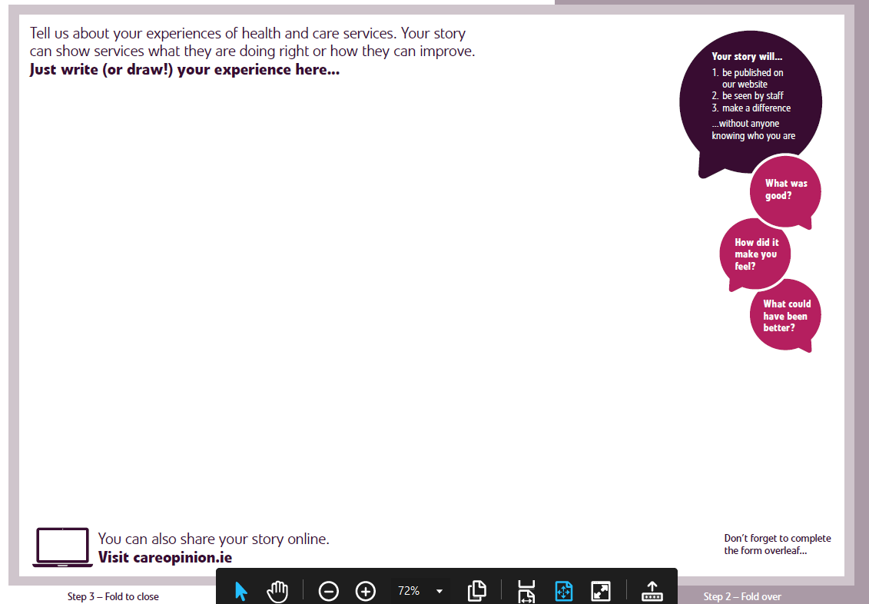

Notes:
FB

Slide 13
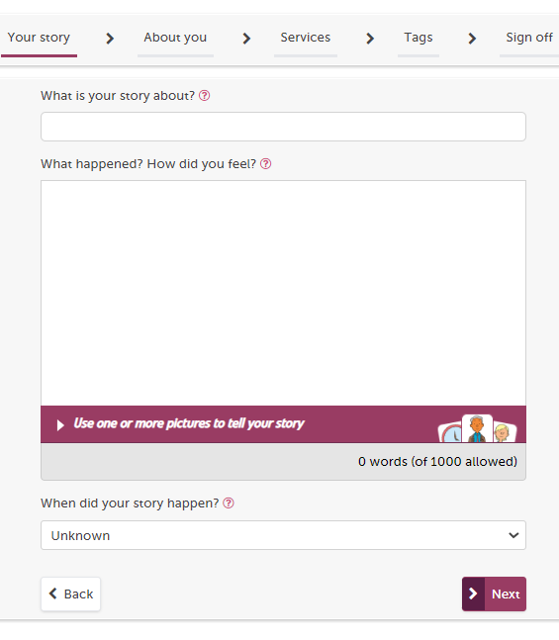
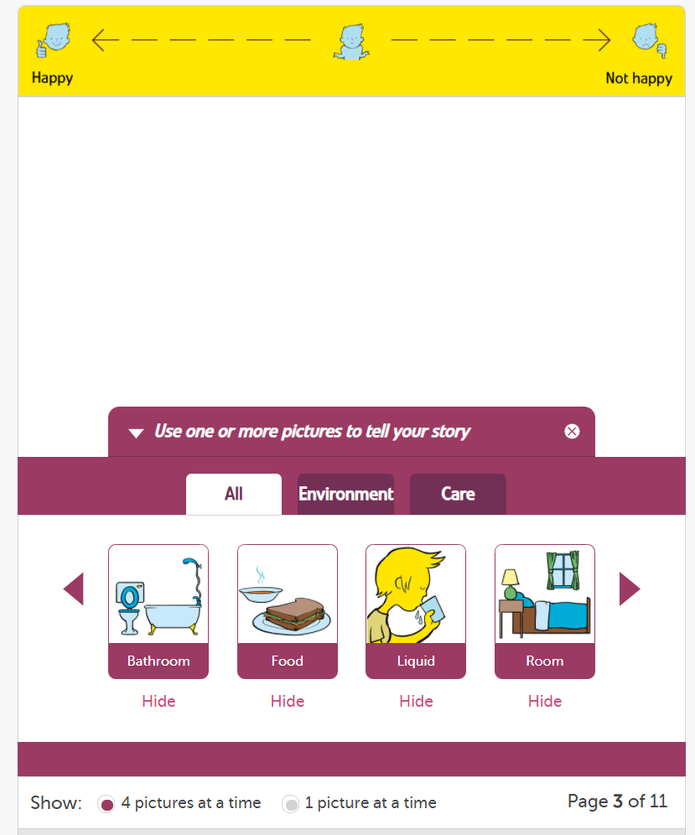
Picture Tiles

Slide 14



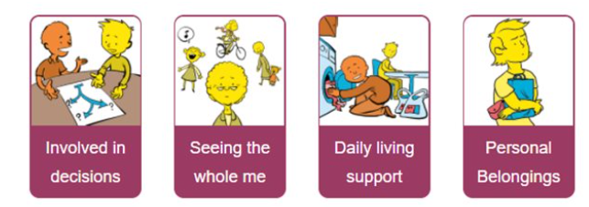
Accessibility
Choice of contrasts and font sizes
BSL and ISL videos
Tell your story using pictures
Use pictures to tell your stories
Picture stories | Care Opinion
Notes:
We have many ways for people to share their feedback with us at Care Opinion.
-Online via our website
-By phone
-Leaflet
Over the years we have also developed a range of tools to help our site be more accessible to those who need it. We have BSL videos, large font sizes and contrasts to make the information easier to read. The website can also be translated into other languages.
To help children and young people to share their stories, we have an adapted, simplified version on the website which is branded with Monkey (that you can see here).
We have also done some great work with Talking Mats and with their support people can now share their stories using pictures, where spoken or written language may be a barrier.

Slide 15











The feedback journey…
Author submits their story
Story is moderated
Story is published and responders are notified by email
Staff respond to the story
Can we make any changes that might improve the experience for the next person?
Are we doing something really well and we intend to make it normal practice?
Have we made a change as a result of this feedback?

Slide 16




Moderation Principles
Notes:
So how do we do it?
All feedback that is submitted to Care Opinion is moderated by our team in line with our moderation policy. We are constantly reviewing and updating this policy. This is to make sure that any feedback that we publish is constructive and safe for both staff and patients alike.
For e.g. we will not publish any offensive language, racist or homophobic remarks etc. We remove all staff surnames from stories and also make sure that the author does not reveal any personal information about themselves, such as phone numbers, date of birth or address etc. That is just scratching the surface of moderation, but you can read more about our policy by clicking the link in the presentation.
Once a story has been moderated we will publish it on the website and the service/services will be invited to respond. We provide support and training to the boards on responding well.

Slide 17




Care Opinion’s Moderation Process
First line moderators
Second line moderators
Safeguarding Lead & Team
Moderate stories using our moderation guidelines.
Have access to signposting and safeguarding information & resources.
Receive internal training on safeguarding.
Refer stories of concern to 2nd line moderators.
Provides support and advice to 1st and 2nd line moderators.
Delivers safeguarding training to moderators
Develops safeguarding policies, resources and guidelines.
Staff with more experience/senior members of the team
Will review and discuss any stories of concern or very critical stories.
Provides support and makes decisions around publishing stories.
Notes:
So how do we do it?
All feedback that is submitted to Care Opinion is moderated by our team in line with our moderation policy. We are constantly reviewing and updating this policy. This is to make sure that any feedback that we publish is constructive and safe for both staff and patients alike.
For e.g. we will not publish any offensive language, racist or homophobic remarks etc. We remove all staff surnames from stories and also make sure that the author does not reveal any personal information about themselves, such as phone numbers, date of birth or address etc. That is just scratching the surface of moderation, but you can read more about our policy by clicking the link in the presentation.
Once a story has been moderated we will publish it on the website and the service/services will be invited to respond. We provide support and training to the boards on responding well.

Slide 18


Benefits for Patients:
Its anonymous
They can say what matters to them, not Q&A
Its safe – stories are moderated
They feel listened to and empowered
It can improve care for themselves & others
They can praise staff for doing a good job
They receive a response from staff
May help reduce formal complaints
Benefits for Staff/services:
Safe for staff, not identified
Boost staff morale & change culture
Less paper-based surveys
Can respond in real time
May help reduce formal complaints
Shows the ‘Human side’ to healthcare
Can use feedback constructively
Publicly show learning & change

Slide 19
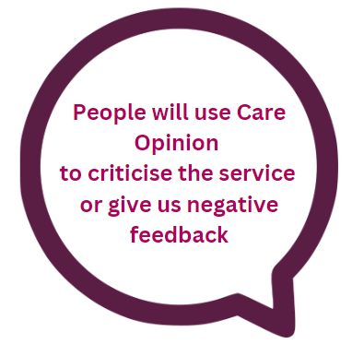
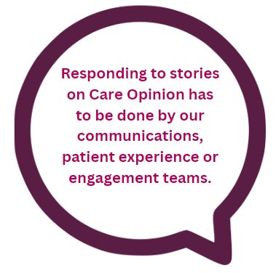
Myths of Care Opinion…
If someone has had a negative experience of your service, then yes, they can tell their story on Care Opinion.
Our moderators read every story, and each is subject to our moderation policy.
However, In past 12 months, 82% of the feedback we published was positive! That’s a lot of thanks!
Care Opinion was designed so that staff at the point of care could quickly access stories and respond to them.
The best results and the greatest impact are achieved when point of care staff are directly involved.
It’s your feedback!

Slide 20


Myths of Care Opinion (continued)…
We are pleased to say that, on average, we publish about 95% of stories we receive.
All stories are read by our amazing and hard-working moderators (real people, not machines, or elves!) and reviewed in line with our moderation policy.
Anonymity, relevance and treating staff fairly are high on our agenda when moderating. In positive stories we leave in staff names (first names usually). In all the rest we remove names, genders and any other information which we think might identify staff.
Out of 312 stories shared about Sligo/Leitrim MH services 24 changes have been promised or made as a result of people sharing their feedback on Care Opinion!
We know that this only accounts for some of the impact that stories have.
We don’t count the effect on staff morale of the positive stories but we really should!

Slide 21
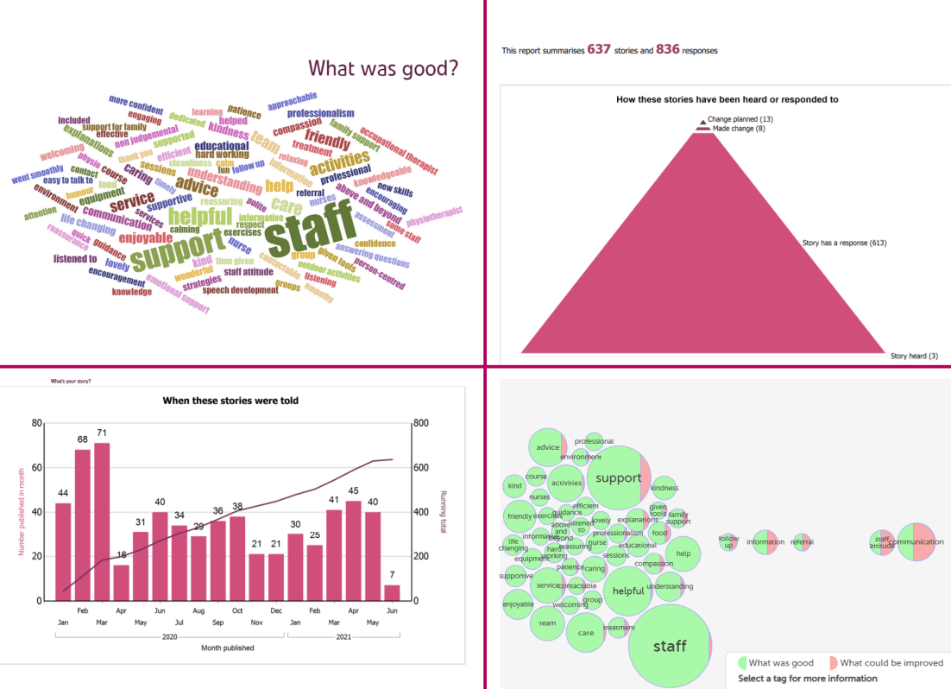
What is reporting and why is it important?
You can create a report for any set of stories within your subscription. You can use our reports to create a listing of stories, or to give a summary of stories and how you are responding to them.
Benefits…
Help maintain an overview of stories and how they are being responded to
Great for management reports/board reports
Filtered by team/clinical area so they can track their own data
Evidence of how you are using patient service user feedback to improve care

Slide 22






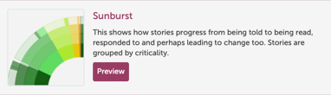


Visualisations
From your searches, you can create interactive visualisations that displays information in a variety of ways, including;

Slide 23
Thank
you

